Slide 1
Business Intelligence Concepts, Tools, and Applications
Week 4: Business Performance Management Systems
Lesson 1: Business Performance Management

Slide 2
Business Performance Management
Learning Objectives
Define the main BPM BPM components
List the four phases of the BPM cycle and the product categories that support each phase
Explain how organizations typically deploy BPM
Notes:
Many organizations are enhancing the capabilities of traditional BI systems to enable even greater monitoring, measurement, and management of business performance than ever before. This corporate, or business, performance management has been touted in industry as one of the more critical applications of BI
Business performance management relies on a tightly integrated MSS application that is implemented through a new wave of BI tools called performance dashboards and scorecards that enable a variety of users throughout the organization to make decisions in a timelier manner by consolidating and analyzing a broad variety of data.
For example, many companies uses these MSS applications to consistently measure regional and unit performance against strategic objectives, and to translate its business strategy into actionable information on which organizational members can base a variety of decisions.

Slide 3
Business Performance Management (BPM)
BPM refers to processes and tools for measuring, monitoring, and managing business performance
It is also known as
Corporate Performance Management (CPM by Gartner Group)
Enterprise Performance Management (EPM by Oracle)
Strategic Enterprise Management (SEM by SAP)

Slide 4
Components of BPM
According to Colbert (2009), a BPM encompasses three key components.
A set of integrated and closed-loop processes for managing financial and operational activities
Tools for defining strategic goals and measuring performance against the goals
Tools for monitoring set of key performance indicators (KPI) linked to organizational strategy

Slide 5
BPM Product Categories
According to Hagerty and Verma (2007) BPM can include the following product categories
Planning, budgeting, and forecasting (PBF)—Contribution, aggregation, manipu­lation, and approval of the financial plan on a periodic or continual basis
Financial consolidations and reporting—Legal and statutory consolidation sys­tems along with more generalized financial statement generation capabilities
Financial analytics and dashboards —Profitability applications, role-specific dash­boards, metrics, and specific financial analytics for detailed financial processes
Financial governance, risk management, and compliance (GRC)—Governance and control requirements that include national and/or international regulations, such as SOX or International Financial Reporting Standards (IFRS)
Scorecards and strategy —Methodology-based scorecards (such as The Balanced Scorecard) and strategy management applications
Notes:
Sources: Hagerty, J and Verma K. “CPM Market Landscape: Office of the CFO is Hot again”. AMR Research Knowledge, and Performance Management, 2007 Technology and Vendor Landscape Series, Market, Services Report Copyright 2007 by AMR Research, Inc.
Dashboards and Scorecards: Linking Management Reporting to Execution by Andreea Vasiliu, Senior Marketing Manager, Hyperion Solutions (Links to an external site.)
.

Slide 6
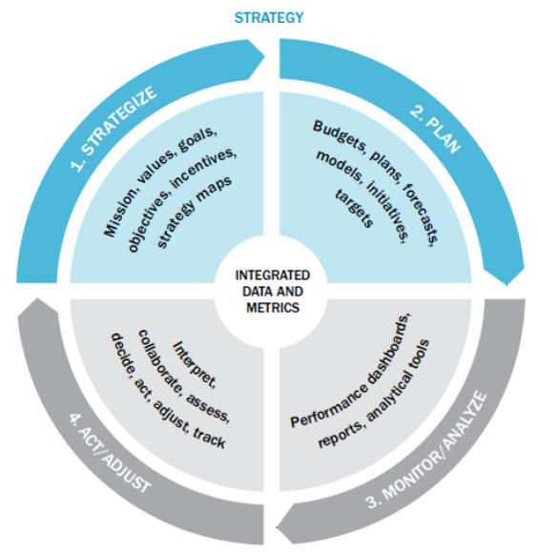
BPM Cycle
From SHARDA, RAMESH; DELEN, DURSUN; TURBAN, EFRAIM, BUSINESS INTELLIGENCE AND ANALYTICS: SYSTEMS FOR DECISION SUPPORT, 10th Edition, © 2015. Used by permission of Pearson Education, Inc., New York, NY. All Rights Reserved.
Notes:
From SHARDA, RAMESH; DELEN, DURSUN; TURBAN, EFRAIM, BUSINESS INTELLIGENCE AND ANALYTICS: SYSTEMS FOR DECISION SUPPORT, 10th Edition, © 2015. Used by permission of Pearson Education, Inc., New York, NY. All Rights Reserved.

Slide 7
Strategize Where do we want to Go?
Common tasks for the strategic planning process:
Conduct a current situation analysis
Determine the planning horizon Conduct an environment scan
Identify critical success factors
Complete a gap analysis
Create a strategic vision Develop a business strategy
Identify strategic objectives and goals
From SHARDA, RAMESH; DELEN, DURSUN; TURBAN, EFRAIM, BUSINESS INTELLIGENCE AND ANALYTICS: SYSTEMS FOR DECISION SUPPORT, 10th Edition, © 2015. Used by permission of Pearson Education, Inc., New York, NY. All Rights Reserved.
Notes:
From SHARDA, RAMESH; DELEN, DURSUN; TURBAN, EFRAIM, BUSINESS INTELLIGENCE AND ANALYTICS: SYSTEMS FOR DECISION SUPPORT, 10th Edition, © 2015. Used by permission of Pearson Education, Inc., New York, NY. All Rights Reserved.

Slide 8
Plan How do we get there?
Operational planning
Operational plan: plan that translates an organization’s strategic objectives and goals into a set of well-defined tactics and initiatives, resources requirements, and expected results for some future time period (usually a year).
Operational planning can be
Tactic-centric (operationally focused)
Budget-centric plan (financially focused)
From SHARDA, RAMESH; DELEN, DURSUN; TURBAN, EFRAIM, BUSINESS INTELLIGENCE AND ANALYTICS: SYSTEMS FOR DECISION SUPPORT, 10th Edition, © 2015. Used by permission of Pearson Education, Inc., New York, NY. All Rights Reserved.
Notes:
From SHARDA, RAMESH; DELEN, DURSUN; TURBAN, EFRAIM, BUSINESS INTELLIGENCE AND ANALYTICS: SYSTEMS FOR DECISION SUPPORT, 10th Edition, © 2015. Used by permission of Pearson Education, Inc., New York, NY. All Rights Reserved.

Slide 9
Monitor/Analyze How we are doing
A comprehensive framework for monitoring performance should address two key issues:
What to monitor?
Critical success factors
Strategic goals and targets
…
How to Monitor?
…
From SHARDA, RAMESH; DELEN, DURSUN; TURBAN, EFRAIM, BUSINESS INTELLIGENCE AND ANALYTICS: SYSTEMS FOR DECISION SUPPORT, 10th Edition, © 2015. Used by permission of Pearson Education, Inc., New York, NY. All Rights Reserved.
Notes:
From SHARDA, RAMESH; DELEN, DURSUN; TURBAN, EFRAIM, BUSINESS INTELLIGENCE AND ANALYTICS: SYSTEMS FOR DECISION SUPPORT, 10th Edition, © 2015. Used by permission of Pearson Education, Inc., New York, NY. All Rights Reserved.

Slide 10
Act and Adjust: What Do We Need to Do Differently
Success (or mere survival) depends on new projectsซ
creating new products,
entering new markets,
acquiring new customers (or businesses), or
streamlining some process.
Many new projects and ventures fail!
From SHARDA, RAMESH; DELEN, DURSUN; TURBAN, EFRAIM, BUSINESS INTELLIGENCE AND ANALYTICS: SYSTEMS FOR DECISION SUPPORT, 10th Edition, © 2015. Used by permission of Pearson Education, Inc., New York, NY. All Rights Reserved.
Notes:
From SHARDA, RAMESH; DELEN, DURSUN; TURBAN, EFRAIM, BUSINESS INTELLIGENCE AND ANALYTICS: SYSTEMS FOR DECISION SUPPORT, 10th Edition, © 2015. Used by permission of Pearson Education, Inc., New York, NY. All Rights Reserved.

Slide 11
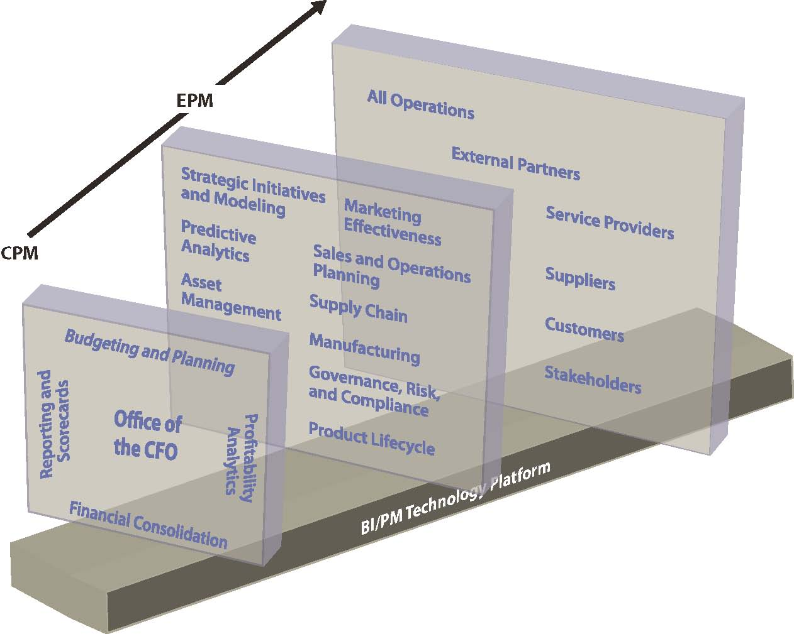
The performance management continuum
Pervasive PM
Adopted from Hagerty, J and Verma K. “CPM Market Landscape: Office of the CFO is Hot again”. AMR Research Knowledge, and Performance Management, 2007 Technology and Vendor Landscape Series, Market, Services Report.
Notes:
Adopted from Hagerty, J and Verma K. “CPM Market Landscape: Office of the CFO is Hot again”. AMR Research Knowledge, and Performance Management, 2007 Technology and Vendor Landscape Series, Market, Services Report.

Slide 12
Getting Started with BPM
Organizations initially deploy BPM in one of three ways:
Functional Approach
Cross-Functional Approach
Big Bang” Enterprise Approach
Source TDWI www.dw-institute.com

